Slide 1

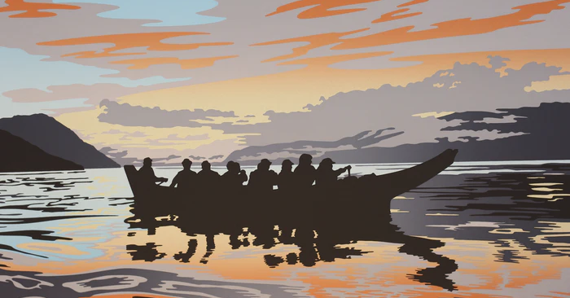
Indigenous Arts
Simon McNeely

Slide 2
How Can We Change our Western Perspectives?
Objects should stay as authentic as possible
Vs.
Objects are meant to be used
Notes:
One of the biggest topics concerning indigenous arts is the questioning of how our western perspectives on the world influence the establishment of conservation ‘rules’ and how these rules should not necessarily be heralded as a universal truth. We have discussed previously about the changing nature of conservation, like with the reconstruction of classical statues during our week on sculpture. However, these perspectives are still rooted in a Western viewpoint of what an object is. The reconstruction of objects through speculation of what they ‘should’ look like implies a desire to restore the past. The subsequent response to instead remove all additions and present the object as a structure containing only its original components is a shift in opinion, but does continue to imply the idea of an eternal, unchanging object. We saw with land art too, that debate around it focused on the question of how to preserve something that, at its nature, is incredibly vulnerable to the ever-fluctuating environment. But what if the purpose of an object is to be used, to change? What indigenous arts bring to the table is the idea that an object is more than just a physical piece, a representation of an idea. Many indigenous artworks have lives of their own, their position as a cultural item extends beyond the object itself, which is why the idea of agents of decay gets a bit complicated.

Slide 3
Agents of Decay (most of them)
Physical Forces – outdoor structures
Fire – wood, textile, etc.
Pests – wood, textile, etc.
Light – fading of pigment
Incorrect Humidity – wood, textile, paper, etc.
Thieves and Vandals – small artworks, outdoor works
Water – wood, textile, paper, etc.
Pollutants – outdoor works
Incorrect Temperature – outdoor works
Notes:
There are thousands of indigenous groups in the world today and, naturally, each group has individual approaches to art and art making. Therefore, when we get into agents of decay, we see that it is pretty broad. Indigenous artworks range from a wide array of materials, including but not limited to: wood-based and textile weaving, ceramic beads, wood carving, stone carving, glass, ceramics, leather, metal work, quilting, etc. Therefore, when we talk about agents of decay we clearly see that each and every one of them has relevance in one or more aspects of indigenous arts.
Physical forces will have a great impact on outdoor structures, an earthquake or storm could displace a totem pole or damage outdoor rock art. Fire would pose a risk to many of the wooden and textile works. Again, wood and textiles will be vulnerable to pests, insects making homes, laying eggs, etc. Light causes some issue with fading of pigments in paint and such. Incorrect humidity could cause warping or moulding of materials if too humid or fraying if too dry. Lots of indigenous artworks are small, therefore quite susceptable to thieves. Large ones, on the other hand, like rock arts and totem poles, tend to be outdoors, and therefore susceptible to vandalism. Water can warp, stain, cause mould in many objects, wood, textile, paper, etc. Items placed outdoors are particularly vulnerable to pollutants, discolouration, staining, warping, are a few effects that can occur to an exposed object. Incorrect temperature, again, can cause warping and change in an object.

Slide 4

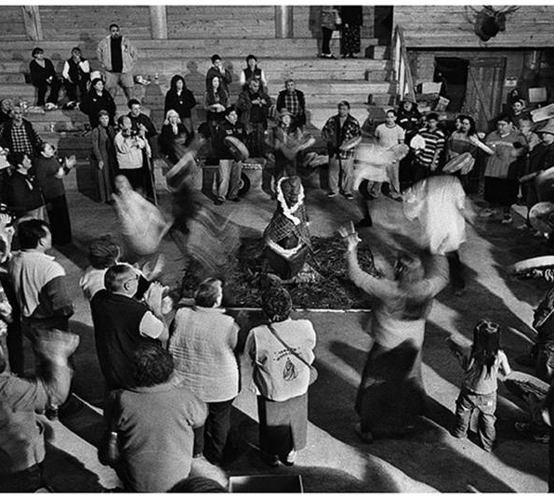

Dissociation
Active matter
Many reasons for dissociation:
Unknown origin
Loss of tradition
Object being cared for improperly
Notes:
The big one, so to speak, is dissociation.
Many indigenous objects’ materiality extends beyond their physicality. They are both active matter themselves and exist as interconnected cultural ideas. This means that the object itself isn’t the thing with inherent value, but much of the value rests on the idea of the object and how it is treated during its natural lifetime. Many indigenous artworks aren’t built to last forever and were never meant to. Therefore, dissociation of many of these indigenous works is definitely an interesting case. As a result of colonialism, many cultures were displaced or lost all together. Objects were seized and taken to museums, collections and other institutions. As a result, the history and use of many objects is missing altogether. If displaced, the knowledge on an objects purpose or how to care for it may be gone. If knowledge on how to handle the object still exists, that doesn’t necessarily mean that the museum personnel are caring for it correctly.

Slide 5
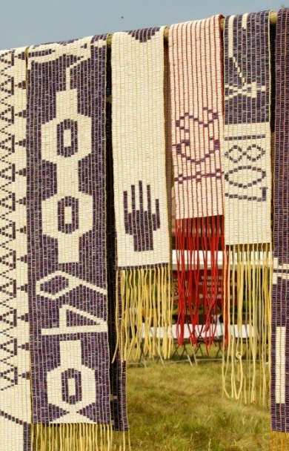
Wampum Belts
Hiawatha, consolation, confederation
Theft and repatriation
Items denied their use, is a replica good enough?
Notes:
First case study I am going to look into is wampum belts, starting with the tale of the peacemaker and a man named Hiawatha founding the Iroquois confederacy. Hiawatha lost his daughters to a man named Tadodaho in the wars between the nations. One day, the Peacemaker found him and used wampum beads to clear his grief, first from his eyes, then his ears, then his throat. After, Hiawatha had a clear mind and begun the process of uniting the five nations under the confederacy. This ceremony became the basis of an Iroquois tradition called the consolation. Considering their role is beginning the Confederacy, the wampum beads are used as a symbol of such. Wampum is used to organize meetings between the nations, as a representation of ones role in society, and to inform listeners during ceremonies that their words are the truth.
But what implications do these belts have in terms of conservation? The Onondaga nation was the group with the responsibility of caring for the belts of confederation, called the Fire Keepers of the grand council of Confederacy. Unfortunately, in the late 1800s and early 1900s the belts wound up in possession of museums, educational institutions, and private collections. They were returned in 1989 after the United States passed the Native American Graves Protection and Reparations Act, where items of cultural value must be returned to the nations they belong to if the institution that holds them receives financial support from the government.
Returning the wampum belts was seen as controversial in some conservation circles, because of the nature of western dominance. There is a presumed authenticity inherent in an object that it should remain the same way forever. Why should items be returned if they are just relics? Wouldn’t putting something to use degrade it, eventually making it obsolete? It is not only the issue with theft as a result of colonization that makes the presence of these items in museums controversial, but also the fact that these items are denied their agency, their use. Can the oral traditions of the Haudenosaunee continue without these beads? Yes, in some aspects. Many Haudenosaunee use glass wampum beads as replacement. However, that doesn’t necessarily mean that it is fair to only consider the western viewpoints when considering the handling of traditional wampum belts. 12 Wampum belts were returned to the Onondaga in 1989. Each belt has a particular purpose. For example, the Hiawatha belt is used during Grand Councils of the Haudenosaunee to remind leaders of the peace and to keep it for the future. It is important to consider the Indigenous perspectives, that theres not simply one way to handle objects.

Slide 6
Art in use?
Should we reconsider how we treat artefacts of ‘western’ origin as well? Why should or shouldn’t we let things be put to use or let them change?
Notes:
We talked about controversies surrounding the use of historical items even in week one, with say, Marilyn Monroes dress or James Madisons flute. Or what about the changing nature of land art? Should we reconsider our conservation approaches to ‘western’ artworks as well? Why can or can’t these things be changeable or usable too?

Slide 7
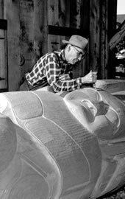
Northwest Coast Totem Poles
Made from western red cedar
Carved then painted
“Scramble for Northwest Coast Artefacts”
Perspectives of totem pole acquisition
“Revival”
Notes:
The next case study I will explore is that of Northwest Coast totem poles. There are two kinds of totem poles: structural totem poles and free-standing poles. Free-standing poles were built to honour the living and the dead. Totem poles are typically carved from western cedar, these trees are large, carvable, and decay slowly. They are then painted. Choices in paint colour vary from place to place.
There is, again, not much consensus on how exactly Northwest Coast totem poles should be conserved. These poles were erected ceremonially, but they had no regular use afterward. Many poles were destroyed as a result of colonialism, but plenty were preserved after being taken to Canadian, European, and American museum institutions. Of course these acquisitions were not treated with any consultation of Native American communities in mind, they were repaired, cleaned, and sometimes repainted by the judgement of museum conservators only. In the late 1800s there was a “Scramble for Northwest Coast Artefacts”. There was a sense of urgency in that the ongoing colonialism of the modern era was killing off native cultures, so the scientific community believed that the theft of these items was an act of preservation.
These, and museum acquisitions in general, are an incredibly controversial topic. Many poles have been repatriated, whether to cultural centers or otherwise. Some indigenous people are thankful, despite the unjust circumstances, that the presence of poles in museum collections led to their preservation. A ‘revival’ of totem pole carving arose in the mid-19th century, with artists like Mungo Martin training new carvers by building modified replicas of those that have been preserved. Even this is controversial to some Native people, that the creation of replicas and the repairing of totem poles is a defilement of the original object.

Slide 8
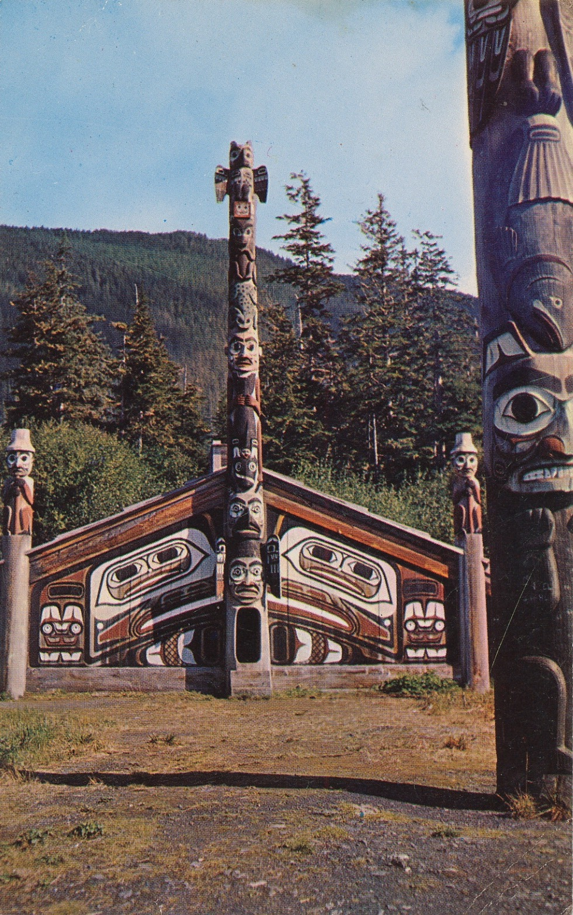
Northwest Coast Totem Poles
Establishing new solutions
Southeast Alaska Indian Arts Council
Ketchikan, Alaska
Strategies for conservation of outdoor poles
Notes:
Other solutions to totem preservation were proposed in the mid 19th century. For example, with the Southeast Alaska Indian Arts Council, which was created to assess ownership and preservation needs of totem poles. The council was established with agreements from people from villages all over Alaska. The council moved poles from small villages to the cultural center at Ketchikan so they could be monitored and conserved. The project was a combined effort between the US forest services, the Alaska Native Brotherhood, the Indian Arts Council, and others to properly assess preservation needs. It was suggested to use a gaseous fumigant that could reach the more internal areas of the totem poles to prevent moulding and infestations. This would be accompanied by water repellant. Vegetation would have to be removed to prevent decay at the base and keep the poles standing strong. These basic conservation rules continue to be used by many totem conservation groups today.

Slide 9
What is authenticity anyway?
If it is tradition to re-build a cultural artefact once it decays or degrades, is it still authentic? Is authenticity a valid metric to use in the first place?
Notes:
It was tradition that, sometimes, when an old totem pole collapsed or was too worn to continue to stand safely, it would be deconstructed and a modified copy would be created by a new carver. Then, a ceremony would be performed to erect the new pole. This is not necessarily a universal solution to a collapsed totem pole. In some cases, the pole would be retired completely. I’m curious about everyones thoughts on authenticity here. If replicas, or almost-replicas (considering it is improper to create an exact replica of another carvers totem pole) should be treated as authentic as the original? Is authenticity even a valid metric in the first place?

Slide 10
Works Cited
Rhyne, Charles S. "Changing approaches to the conservation of northwest coast totem poles." Studies in Conservation 45, no. sup1 (2000): 155-160.
Levitan, Alan. A History of Totem Preservation, (Sitka National Park), 2012, 71.
Carr, Melissa H. "A conservation perspective on the wooden carvings of the Pacific Northwest coast." In Nineteenth Annual Conference of the Graduate Conservation Training Programs in North America, State University College at Buffalo, Art Conservation Department. 1993.
Powless, Irving, “The Day that 12 Wampum Belts Returned to Onondaga”, Onondaga Nation, January 27, 2021, https://www.onondaganation.org/culture/the-day-that-12-wampum-belts-returned-to-onondaga/
Jamie Jacobs, “The Orator’s Dilemma: Wampum as material, media, medicine, and memory,” Conserving Active Matter, Peter N. Miller and Soon-Kai Poh, eds. (New York: Bard Graduate Center, 2022): 246-263.
Clavir, M. “Historical Development of Conservation and its Values.” In Preserving What is Valued: Museums, Conservation, and First Nations. Vancouver and Toronto: UBC Press. 2002. p.3-25.

